Slide 1
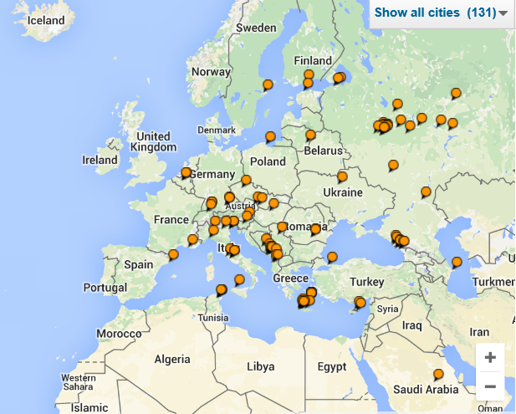
What you know about your users and apps based on Application Insights and Mobile Engagement telemetry?
Igor Sychev
Azure/Dev Premier Field Engineer (PFE)
Microsoft

Slide 2
Agenda
Azure Application Insights
Azure Mobile Engagement

Slide 3
You deployed your app. What usually happening with your app next?

Slide 4
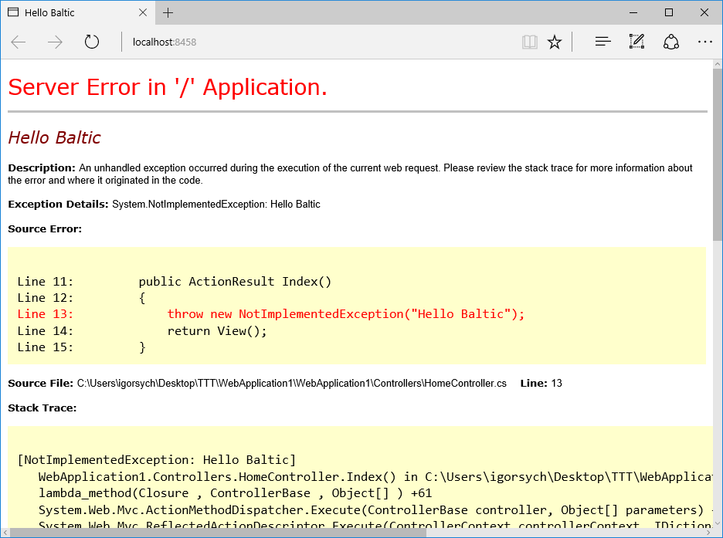

Slide 5
Facing These Questions?
Am I meeting my service Key Performance Indicators (KPIs)?
Is my application crashing?
How many people are impacted?
What is the root cause?
Is my application loading fast enough?
What exactly was going on?
How responsive are my dependency calls?
Is my application Up or Down?
Is my server able to handle the load?

Slide 6
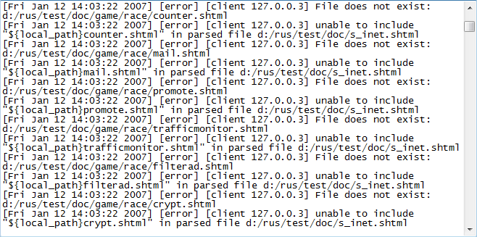
You have logs to answer on all questions, right?
You like reading logs
Friday afternoon?

Slide 7
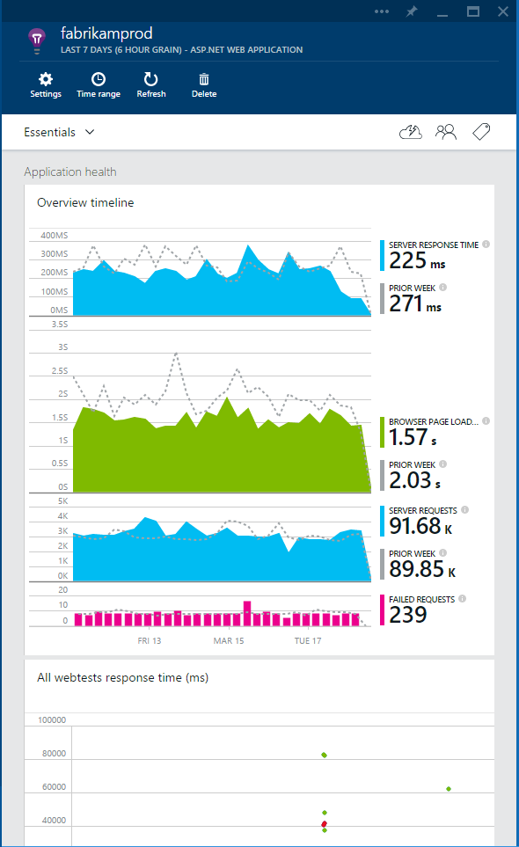
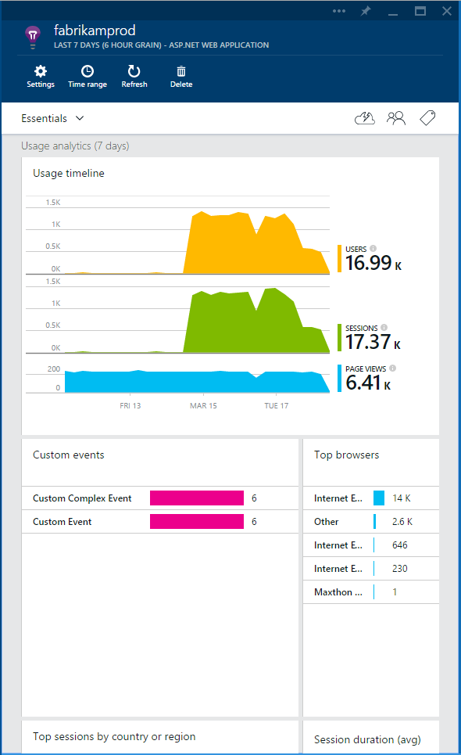
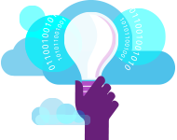
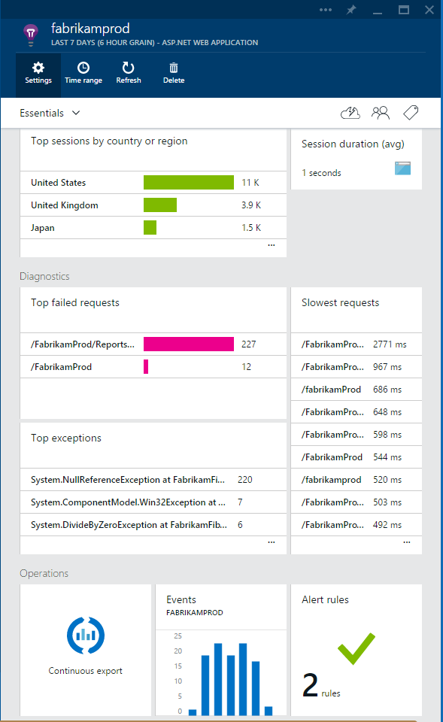
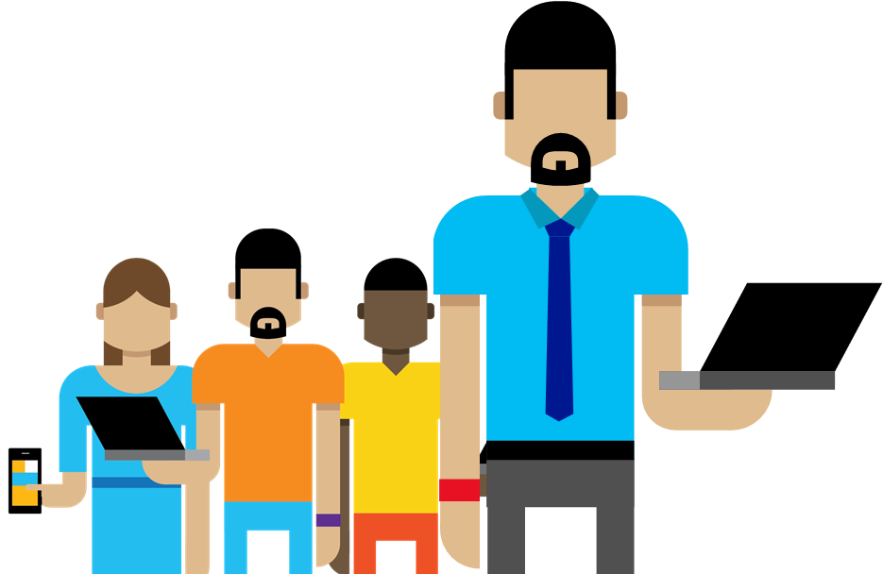
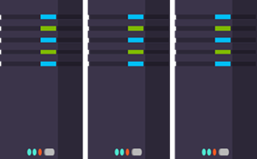
What Is Application Insights?
3
1
Get a 360° view of the application including availability, performance and usage patterns
Telemetry is collected at each tier: mobile applications, server applications and browser
2
Telemetry arrives in the Application Insights service in the cloud where it is processed & stored

Slide 8
Demo: Get Started

Slide 9









Supported Platforms and Languages
Any Platform - Any App
On-premises, Azure, Amazon Web Services (AWS), Google Cloud, App Stores
Open Source SDKs
Logging Frameworks
Log4Net, nLog, System.Diagnostics, Log4J, Logback
Notes:
Open Source SDKs https://github.com/Microsoft/ApplicationInsights-Home

Slide 10
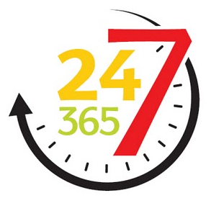
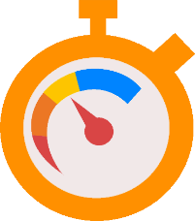

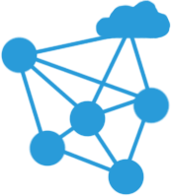
Real World Problems
Service Level Impact
Operational Level Impact
Availability
Responsiveness
Reliability
Latency

Slide 11
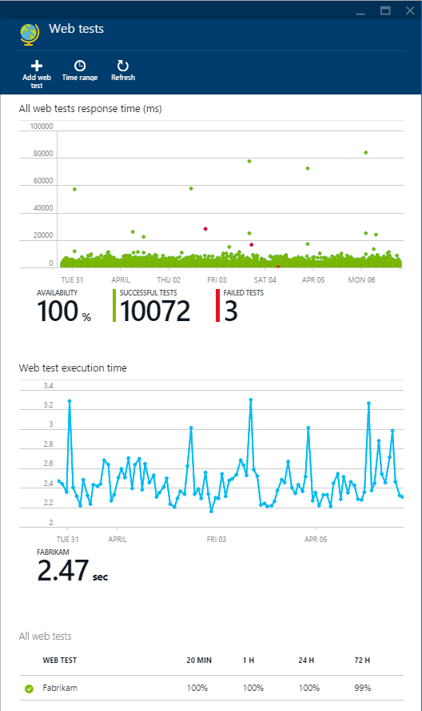
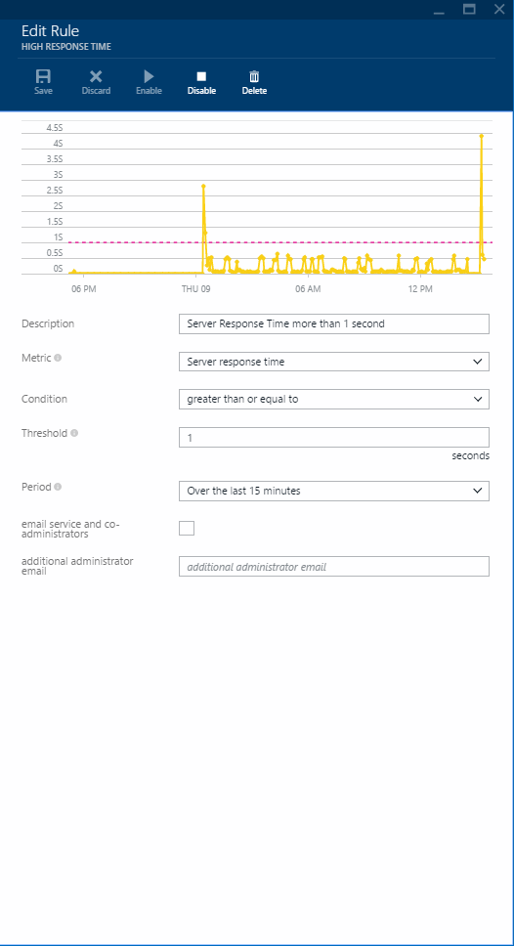
Identify and Triage Issues: Availability
Challenges
Visibility to application health?
Visibility to application outages to minimize
customer impact?
Hard to get information to determine impact
of issue?
Solutions
Reduce ‘Mean Time to Detect’
Ensure service availability with 16 global points of
presence
URL ping tests and rich multi-step web tests
Threshold based alerts on metrics and performance counters

Slide 12
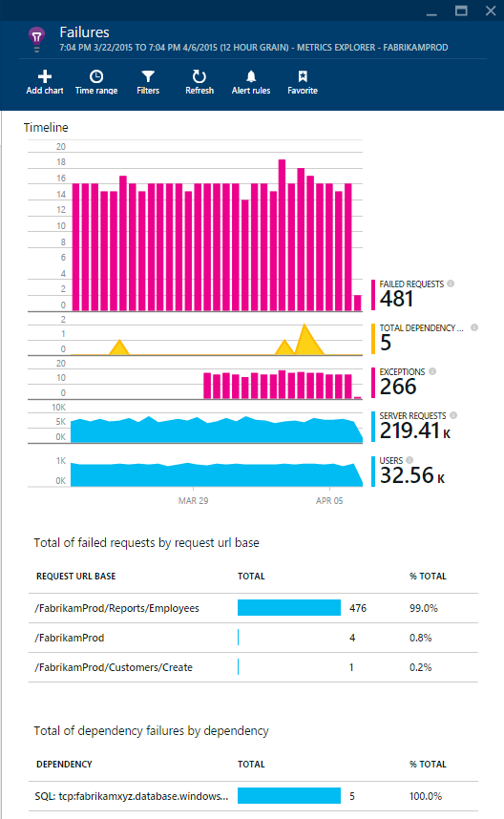
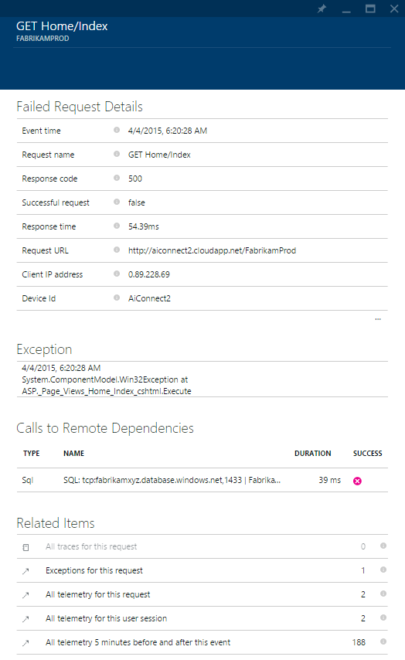
Diagnose and Solve Problems: Performance
Challenges
Uncover root cause of issues
in production?
Monitor app responsiveness?
Solutions
Reduce ‘Mean Time to Resolve’
Identify issues with request rate and dependency response times
Multi-dimensional analyses over custom and default metrics
Drill through exceptions and failed requests with races and runtime telemetry

Slide 13
Learning About Your Customers
Flow/Engagement
Adoption
What are they doing?
User Profile
How many users?
Where are they coming from?
Active Users
New Users
Sessions
Page Views
Avg. Session Length
Time between sessions
Custom Events
Custom Metrics
Country
Browser version
App version
Operating System
Screen resolution
Device model
Locale
Many more to come…

Slide 14
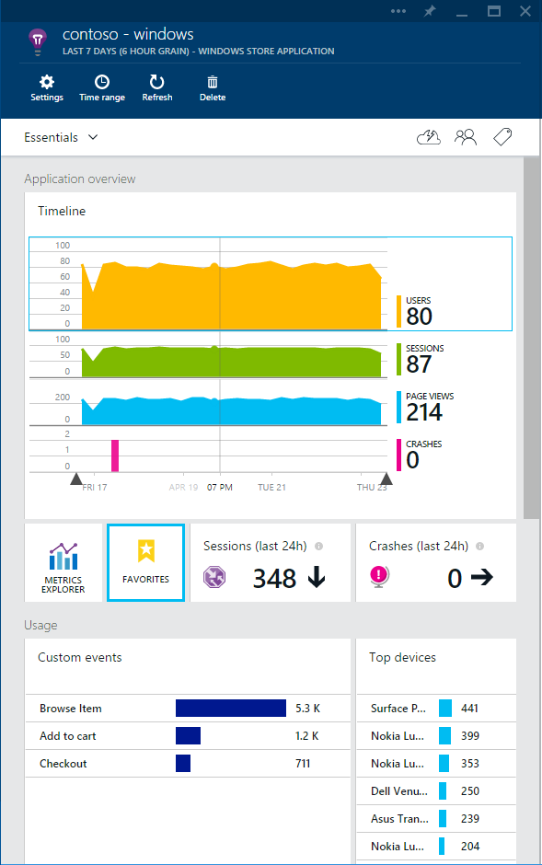
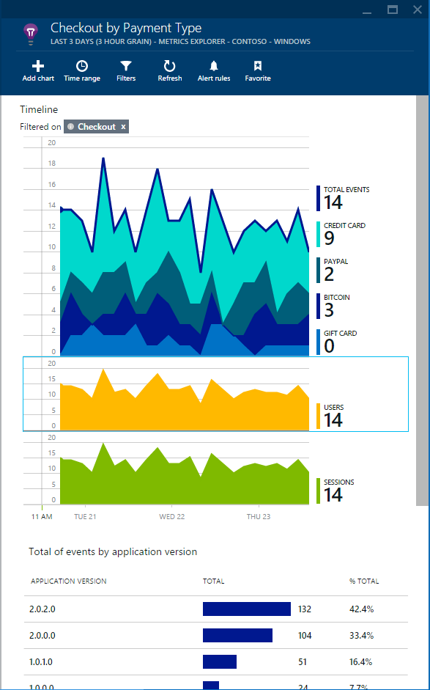
Learn and Improve Continuously: Usage
Challenges
Unable to correlate with other
data sources?
Lack of information to prioritize future investments?
Solutions
Understand key adoption trends
Prioritize investments and support specific client
environments
Custom event instrumentation and client page views
Export data to manually correlate with external
data sources

Slide 15
Execution Mode
Different execution mode when running Application Insights in:
Debug : Development Mode
Instantaneous send
Release : Production Mode
Batch send of data

Slide 16
Track Method
TrackTrace
Example: any logs, warning, etc.
TrackMetric
Example: e-commerce selling t-shirt would be tracking number of sold items
TrackRequest
Custom trace for dynamic/punctual to fine-tuned query, investigations
Track anything that is purely numeric
Collect information about a request outside of the usual application workflow.
Notes:
TrackEvent : custom event to track any specific feature or activity
can set any properties & metrics.
Let you analyze how user use your product, how feature are used
TrackDependency :

Slide 17
Custom Events
Let you track
User flow/behavior
Feature usage
Business goals
Help you make data-driven decisions
Examples:
 | Type of app | Custom Event | Properties | Metrics
1 | Game | Level Completed | Level number Difficulty | Time to complete Number of attempts
2 | e-commerce | Add to cart | Item name Item category | Price Count of items

Slide 18
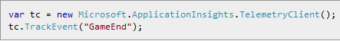
Custom Events
Need to understand how your application is being used.
Can define custom event to track features, scenarios or any miscellaneous actions you wish to monitor

Slide 19
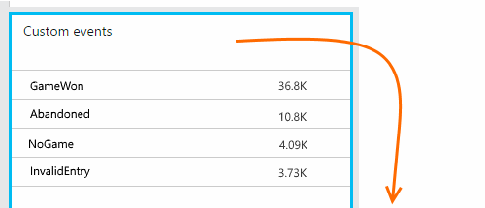
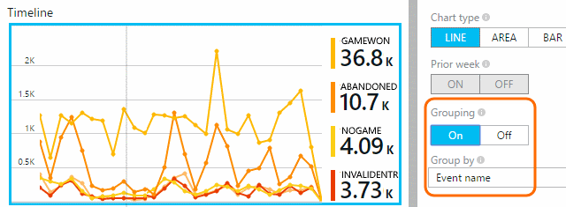
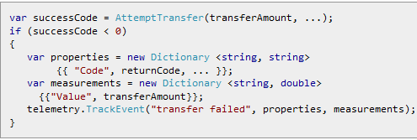

Slide 20
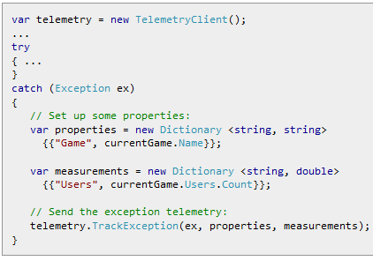
Exception
Capture full stack trace
Collect additional data using properties and measurements

Slide 21
Summary
Application insights –360 overview of you app based on telemetry
Deployment in Azure is not prerequisites for your app
SDK for Java, C#,C++, JS, PHP, ObjectiveC

Slide 22
69% of users open an app <10 times 25% of users use an app just once!

Slide 23
Push Notifications
90% of push notifications are read within 15 minutes after reception
Push notifications are 10 times more effective than marketing emails
Apps using notifications double their retention rate

Slide 24
Azure Mobile Engagement is a SaaS delivered platform that enables:
app user analytics
fine-grain user segmentation
contextually-aware smart push notifications

Slide 25



How Azure Mobile Engagement works
CMO
Insights
Dashboard
Collect Data
Azure Mobile Engagement Platform
Tracking
Campaign Management
Marketers
Data mining
Analysis
Push communications & in-app messaging
Developers
APIs
Optimization
Monitoring
Performance
Analyze
Segment
Push
Your Frontend
Customer
Applications

Slide 26




Develop using any platform
Apple iOS SDK
Supports Apple Watch notifications
Google Android SDK
Supports Amazon Kindle
Windows SDK
Windows 8.1 & Windows 10 UWP; Windows Phone Silverlight
Apache Cordova SDK
Cross platform for Cordova/PhoneGap
Coming soon – Xamarin, Unity, Web SDKs

Slide 27






Open APIs
Integrate into applications easily with open APIs
Leverage existing data from CRM, CMS, and other business related systems
Improve audience targeting and integrated with existing investments
IMPORT EXTERNAL DATA
EXPORT DATA
Segmentation from external data
Notification Campaigns with triggers from external data
Export campaign data to SQL, other DB
Export data to Azure Storage and/or Machine Learning
Azure
Mobile Engagement
Azure Machine Learning
Azure Blob Storage

Slide 28
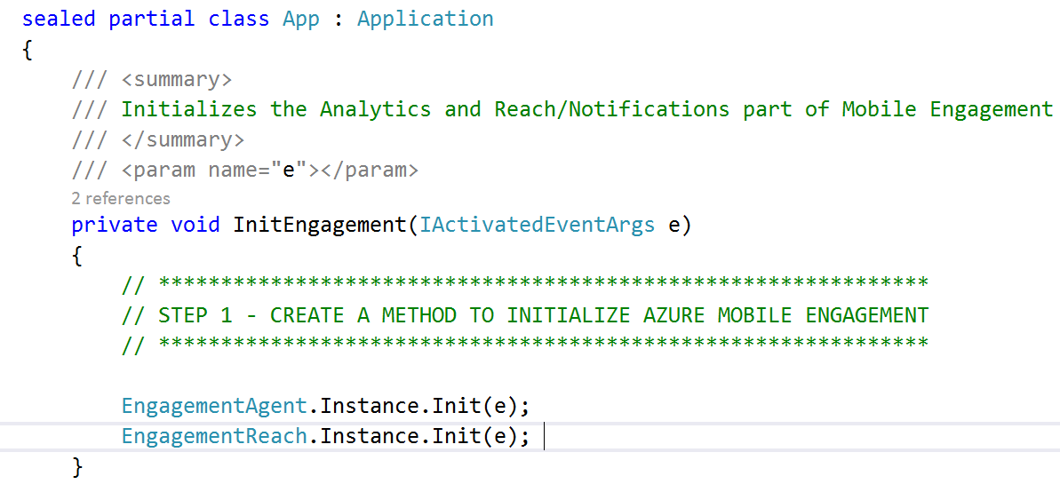
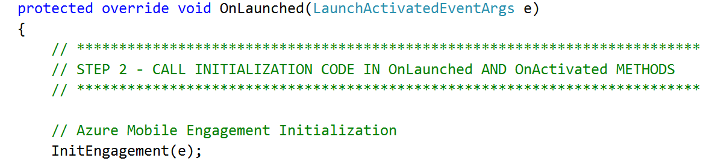
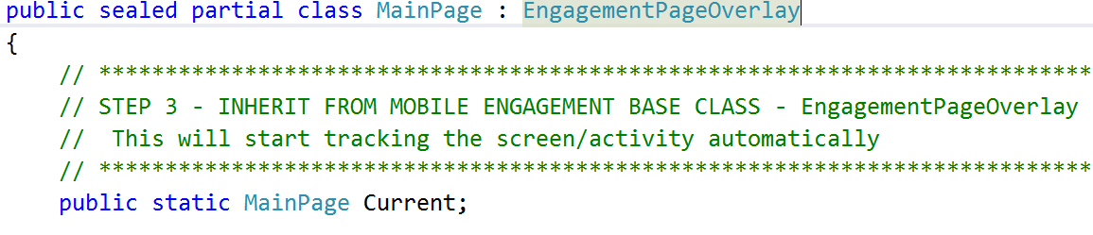
Integrate the SDKs with few lines of code
1
2
3

Slide 29
Basic concepts with SDK integration
Automatic collection
Devices & Users
Sessions
Activities/Screens
Crashes
Additional instrumentation
Errors
Events
Jobs
Tags/ App-info

Slide 30
Key Scenarios

Slide 31
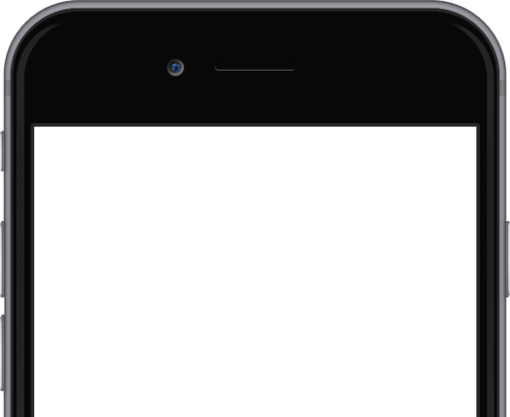



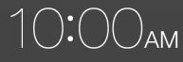

Maximize Usage
Day 1
Keys to success
Ensure the welcome invitation highlights the value of your app
Personalize based on robust user data
Use multi- language capabilities based on device locale
Welcome to the Woodgrove Bank app!
Log in to stay informed on your account.
Log in
Day 10
Opportunity
Multi-step campaign to encourage account creation
Did not create account
What's your balance? Log in and manage your account on the go.
Benefit
Increase app usage and user retention by 80% during the early days
Created account
Jessica, your mobile deposit is ready.
Jessica, votre dépôt mobile est prêt.
Not active
Jessica, check out your latest money saver tip!

Slide 32
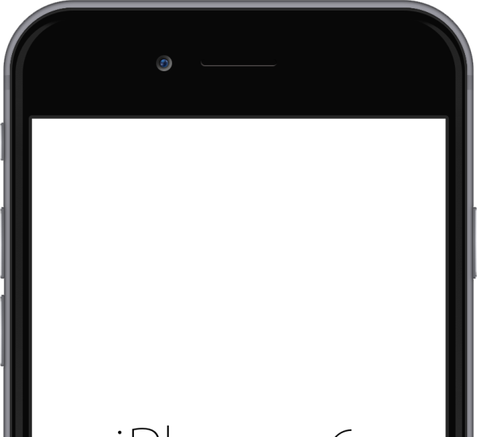

Maximize Retention
Keys to success
Use real-time performance monitoring and alerting to determine which users are impacted
Segment the impacted users
Inform the users about your investigation and eventual fix/updated version
ReleCloud Wireless
Opportunity
Automated message sent when app crashes to tell user that you're aware and working on a fix, and when fix is available
We’re Sorry
Something went wrong, but we’re working on a fix right now.
Benefit
Increase user retention and, when phrased well, can increase user loyalty
ReleCloud Wireless
All fixed!
Back to your regular programming

Slide 33
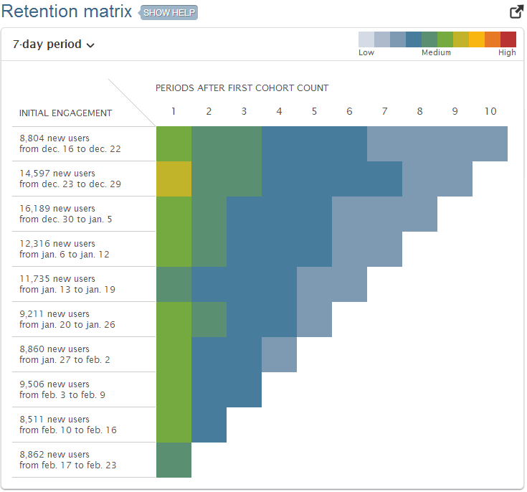
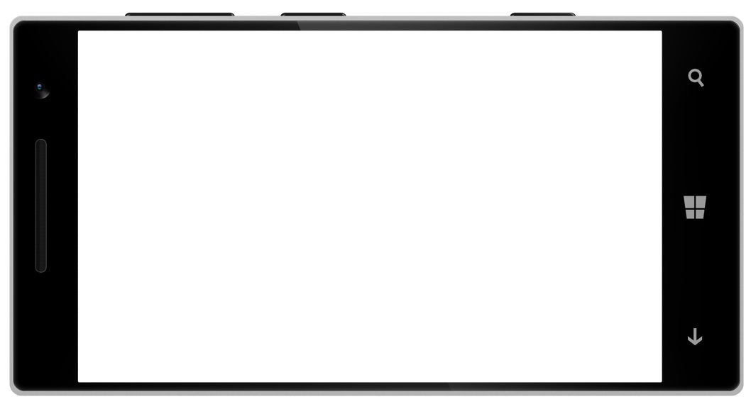
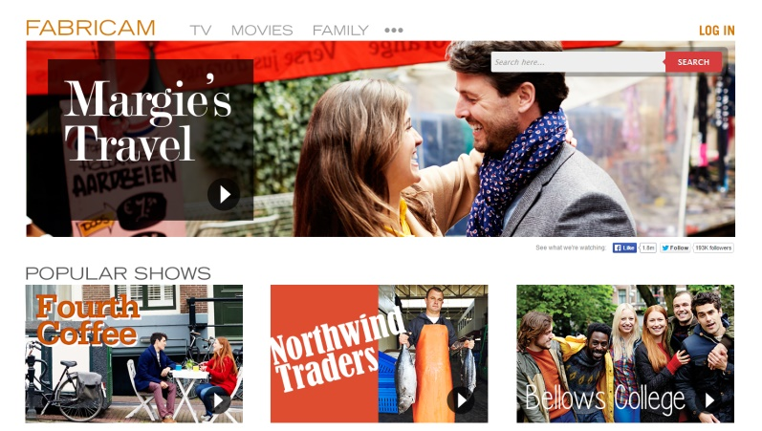
Maximize Monetization
Keys to success
Dynamic user segmentation can help you optimize your message and timing
Utilize in-app messaging to reach a warm prospect
Tune your execution as you go with real-time information on campaign performance
Opportunity
When a user's subscription/trial is about to expire, renew now (or free→premium membership)
X
Benefit
Retain users and increase profitability
Your trial is about to expire
Sign up now!
No thanks
Yes! Sign me up!

Slide 34
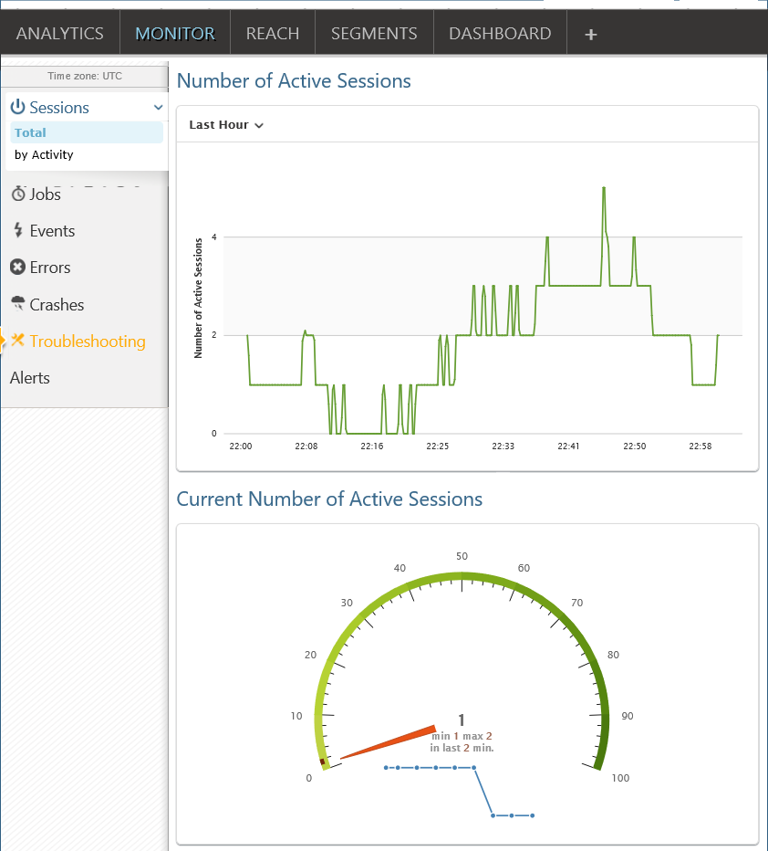
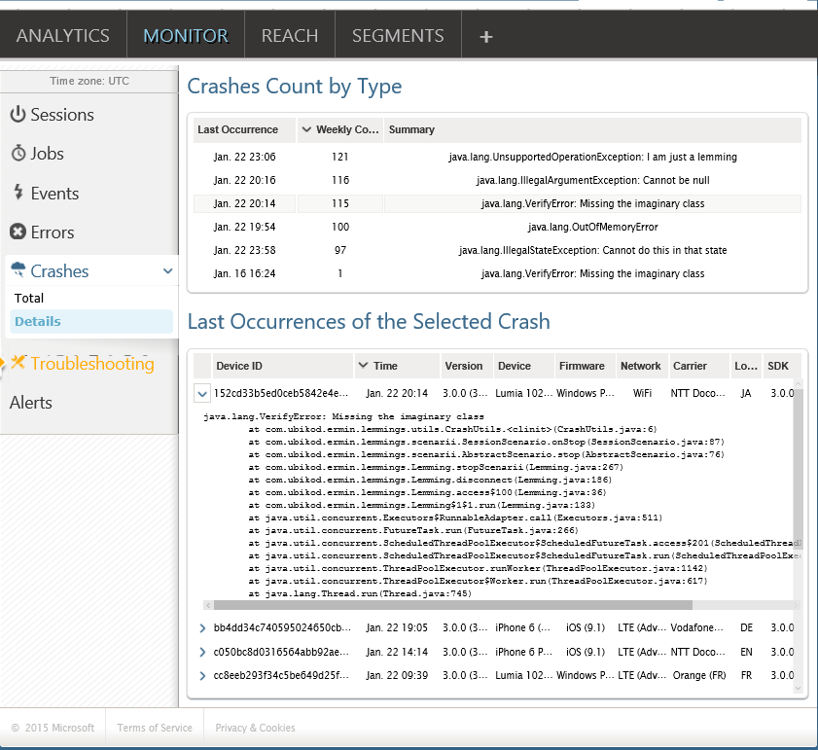
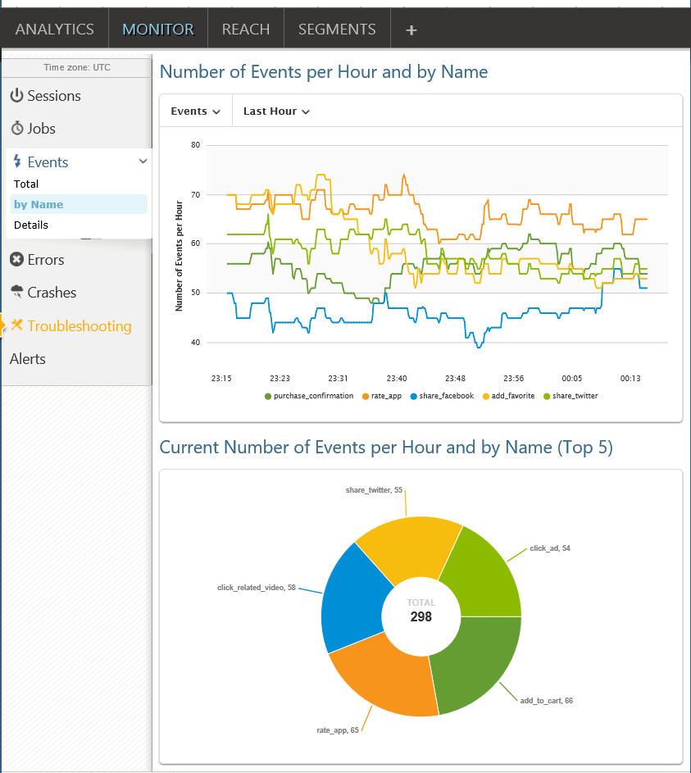
Monitor collected data in real time
Real time Crash reporting
Real time Events
Real time Sessions

Slide 35
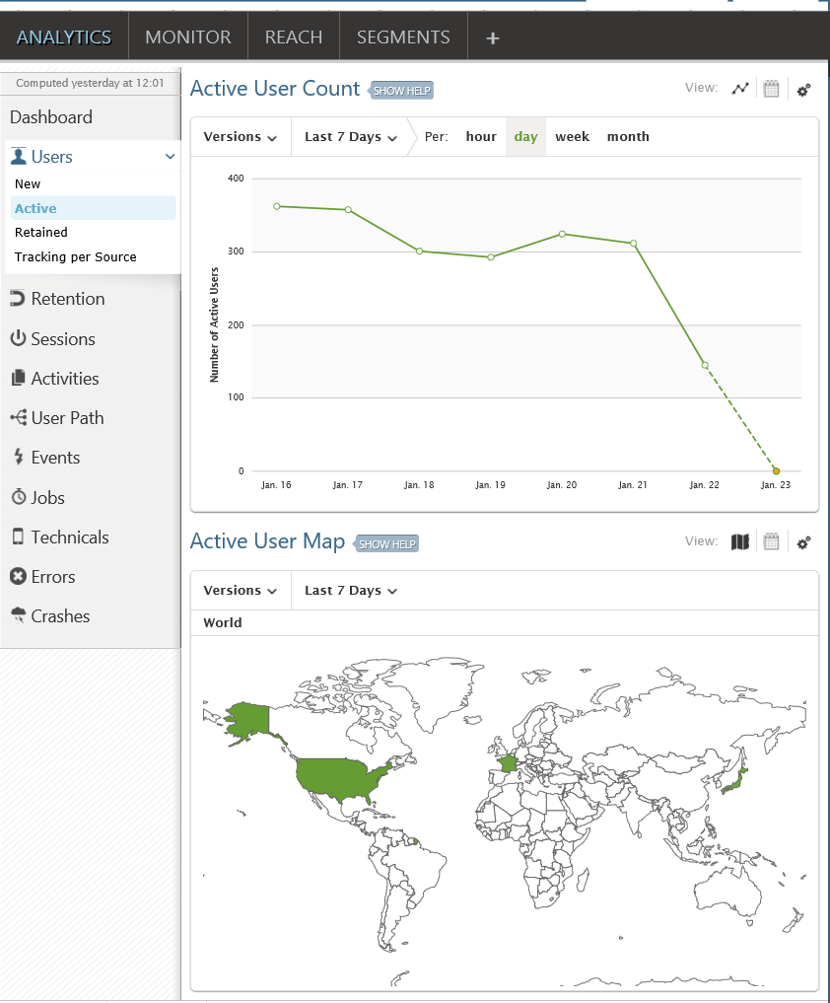
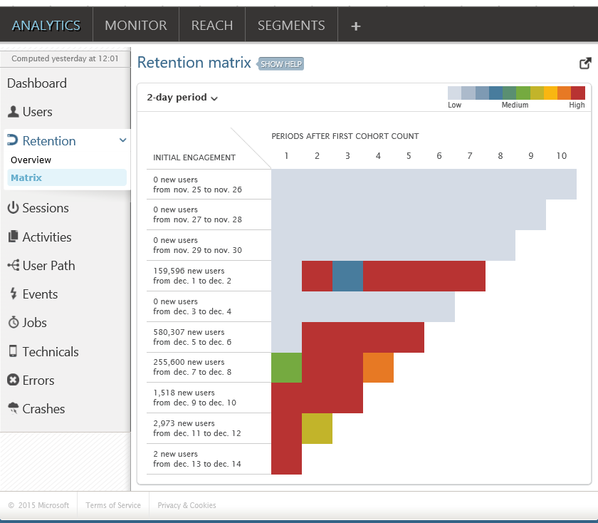
View aggregated analytics
Retention
Users

Slide 36
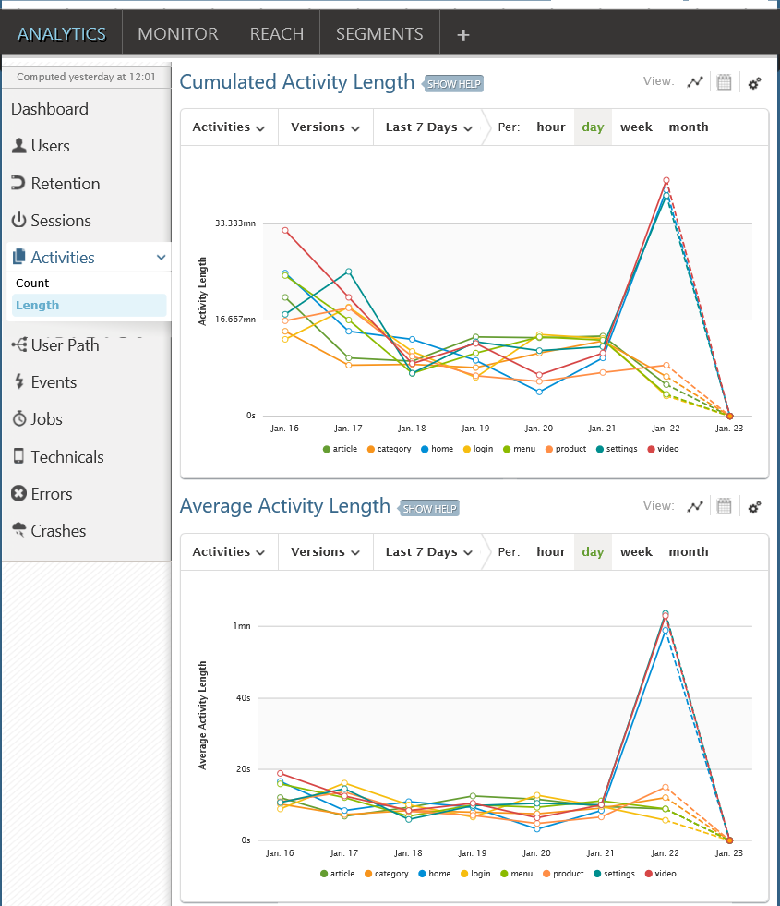
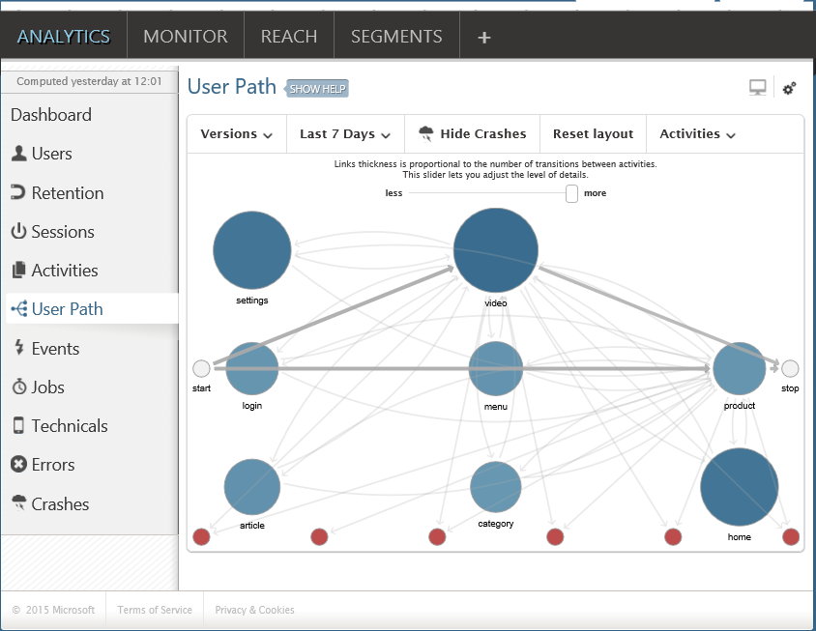
View aggregated analytics
User path based on Activities
Activities /Screens

Slide 37
Demo: Instrument a Windows 10 UWP for Analytics

Slide 38
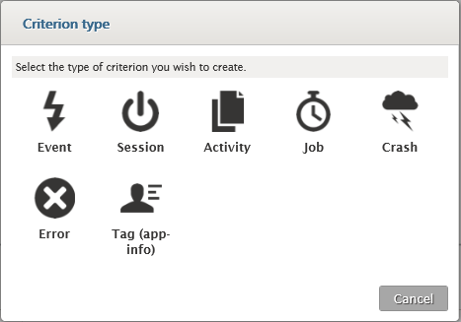
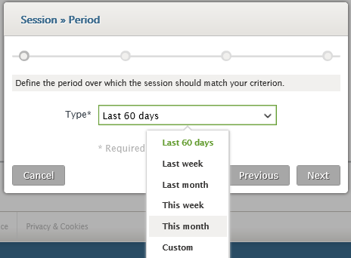
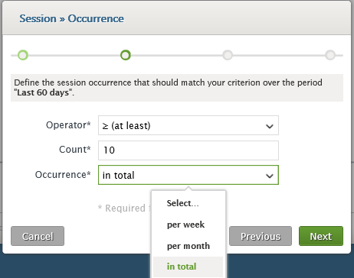
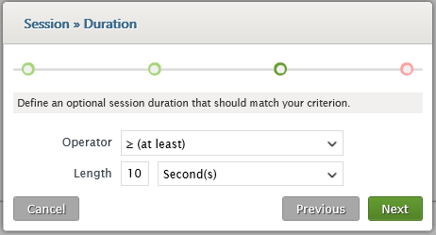
Create user segments
Configure the different parameters of the criterion to create the segment – all via UI
Choose criterion type

Slide 39
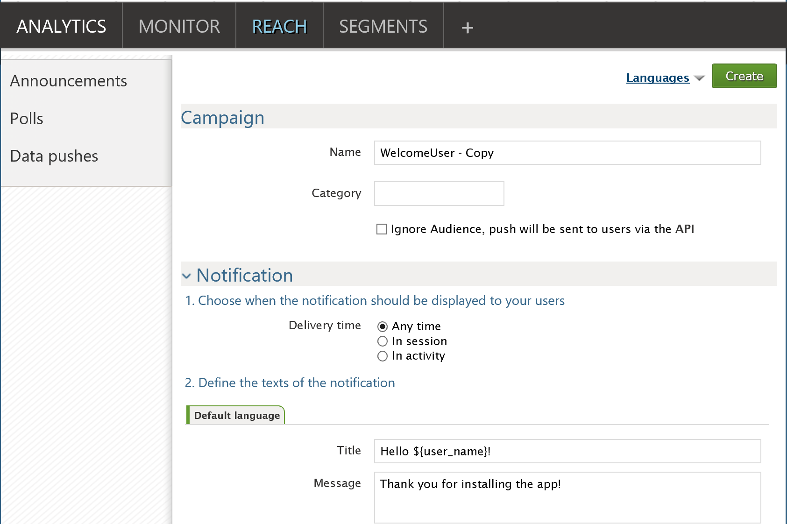
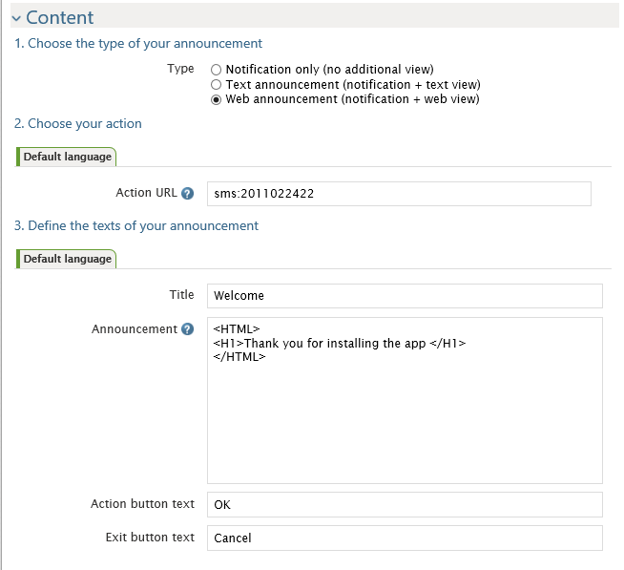
Sending notifications
Configure Anytime/In-session/In-activity
Configure Text/Web or HTML content

Slide 40
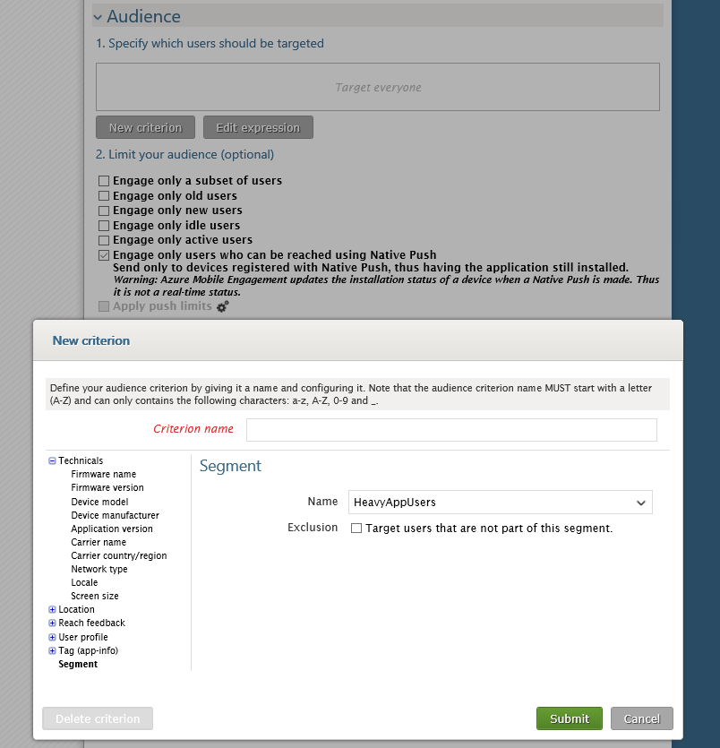
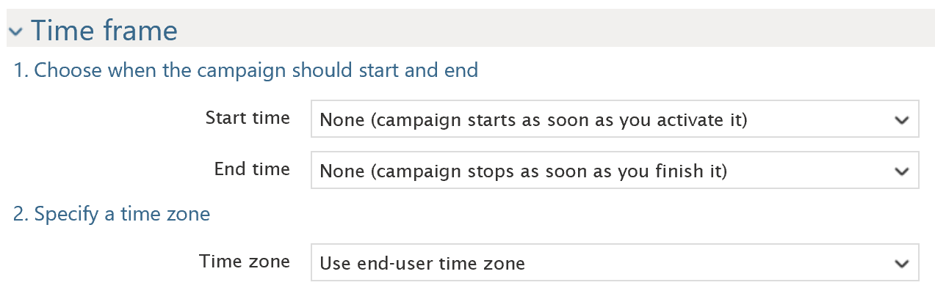
Targeting notifications

Slide 41
Demo: Send notifications

Slide 42


Slide 43


